Slide 1
Dueling Network Architectures for Deep Reinforcement Learning
Ferrari Enrico
University of Trento

Slide 2
CONTENTS
In this project I analyzed the use of Dueling Neural Network for
Policy Evaluation
Corridor example
Policy Learning
Brekout Atari game
Main reference: “Dueling Network Architectures for Deep Reinforcement Learning – Ziyu Wang and others – 2016”

Slide 3

FUNCTION APPROXIMATION FOR POLICY EVALUATION
In a RL experiment, we are given a policy $π$:
$$Q_{π}\left(s,a\right)= ?$$
We model
$$Q_{π}\left(s,a\right)≈Q_{W}\left(s,a\right)$$
SGD with online sampling experience $\left\{\left(s_{1},a_{1}\right),….,\left(s_{n},a_{n}\right)\right\}$,
$$W_{k+1}=W_{k}−η⋅∇_{W}{\left(u_{k}−Q_{W}\left(s_{k},a_{k}\right)\right)}^{2}{\left.​\right|}_{W=W_{k}}$$
e.g. SARSA target
$$u_{k}≔r_{k}+γ⋅Q_{W_{k}}\left(s_{k+1},a_{k+1}\right)$$

Slide 4
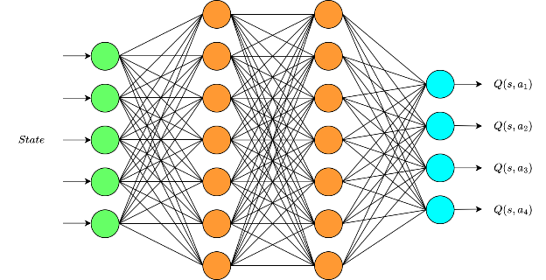

NEURAL NETWORKS AS MODEL
We use a Deep Q-Network
$$Q_{π}\left(s,:\right)≈NN_{W}\left(s\right)$$

Slide 5
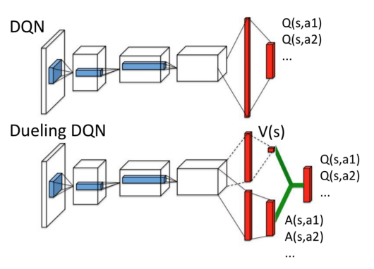

DUELING DEEP Q-NETWORK
$$Q_{π}\left(s,a\right)=V_{π}\left(s\right)+A_{π}(s,a)$$
We use a Dueling Deep Q-Network
$$Q_{π}\left(s,a\right)≈NN\left(s,a\right)$$
$$=φ\left(V\left(s\right),A\left(s,a\right)\right)$$

Slide 6
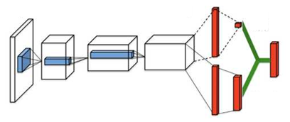





$$V_{W}\left(s\right)$$
$$φ$$
$Q_{W}\left(s,a\right)$ $≈Q_{π}(s,a)$
$$A_{W}\left(s,a\right)$$
Which module $φ$?

Slide 7


Identifiability PROBLEM
Suppose
$$Q_{π}\left(s,a\right)≈Q_{W}\left(s,a\right)$$
We could take
$$Q_{W}\left(s,a\right)=\hat{V}\left(s\right)+\hat{A}\left(s,a\right)$$
$$\hat{V}\left(s\right)≔V_{W}\left(s\right)$$
$$\hat{A}\left(s,a\right)≔A_{W}\left(s,a\right)$$
$$⇒ Q_{W}\left(s,a\right)=\left(V_{W}\left(s\right)+l\right)+\left(A_{W}\left(s,a\right)−l\right) ∀ l$$

Slide 8


Identifiability PROBLEM: max module
Suppose
$$Q_{π}\left(s,a\right)≈Q_{W}\left(s,a\right)$$
We prefer to take
$$Q_{W}\left(s,a\right)=\hat{V}\left(s\right)+\hat{A}\left(s,a\right)$$
$$\hat{V}\left(s\right)≔V_{W}\left(s\right)$$
$$\hat{A}\left(s,a\right)≔A_{W}\left(s,a\right)−\max_{a′}{A_{W}\left(s,a^{′}\right)}$$

Slide 9



Identifiability PROBLEM: max module
Since for any state $s$ holds
$$E_{A∼π(s,a)}\left[A_{π}\left(s,A\right)\right]=0$$
and our estimates satisfy:
$$E_{A∼π(s,a)}\left[\hat{A}\left(s,A\right)\right]=\sum_{a}{A_{W}\left(s,a\right)⋅π(s,a)}−\max_{a′}{A_{W}\left(s,a^{′}\right)}$$
$$=A_{W}\left(s,π(s)\right)−A_{W}\left(s,\underset{a^{′}}{argmax} Q_{W}\left(s,a^{′}\right)\right) = 0$$
=> If $π$is a deterministic and optimal policy, there’s a strong gain in identifiability
If $π$ is deterministic
If $π$ is optimal too

Slide 10

Identifiability PROBLEM: AVG module
Suppose
$$Q_{π}\left(s,a\right)≈Q_{W}\left(s,a\right)$$
We prefer to take
$$Q_{W}\left(s,a\right)=\hat{V}\left(s\right)+\hat{A}\left(s,a\right)$$
$$\hat{V}\left(s\right)≔V_{W}\left(s\right)$$
$$\hat{A}\left(s,a\right)≔A_{W}\left(s,a\right)−\frac{1}{\left|A\right|}\sum_{a′}{A_{W}\left(s,a′\right)}$$

Slide 11

Identifiability PROBLEM: Avg module
Since for any state $s$ holds
$$E_{A∼π(s,a)}\left[A_{π}\left(s,A\right)\right]=0$$
and our estimates satisfy:
$$E_{A∼π(s,a)}\left[\hat{A}\left(s,A\right)\right]=\sum_{a}{A_{W}\left(s,a\right)⋅π(s,a)}−\frac{1}{\left|A\right|}\sum_{a^{′}}{A_{W}\left(s,a^{′}\right)}$$
$$=\sum_{a}{A_{W}\left(s,a\right)⋅\left(π\left(s,a\right)−\frac{1}{\left|A\right|}\right)}$$
=> Gain in identifiability

Slide 12


Max module vs avg module
MAX MODULE
It allows very good estimates for $V_{π}$ and $A_{π}$, if $π$ is close to be detereministic and optimal.
$$\hat{A}\left(s,a\right)≔A_{W}\left(s,a\right)−\max_{a′}{A_{W}\left(s,a^{′}\right)}$$
AVG MODULE
It allows valid estimates for $V_{π}$ and $A_{π}$ for any policy $π$.
Subtracting the average introduces stability on the target.
$$\hat{A}\left(s,a\right)≔A_{W}\left(s,a\right)−\frac{1}{\left|A\right|}\sum_{a′}{A_{W}\left(s,a′\right)}$$

Slide 13


$$V_{W}\left(s\right)≈V_{π}(s)$$
$$φ$$
$Q_{W}\left(s,a\right)$ $≈Q_{π}(s,a)$
$${\hat{A}}_{W}\left(s,a\right) ≈A_{π}\left(s,a\right)$$

Slide 14

Benefits of dueling architecture
In case there are many couples $(s,a)$ such that
$$\frac{A_{π}\left(s,a\right)}{V_{π}\left(s\right)}≈0$$
then we expect faster convergence.

Slide 15

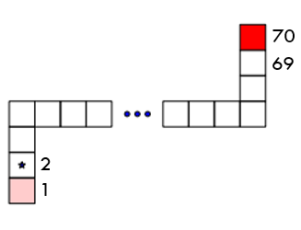
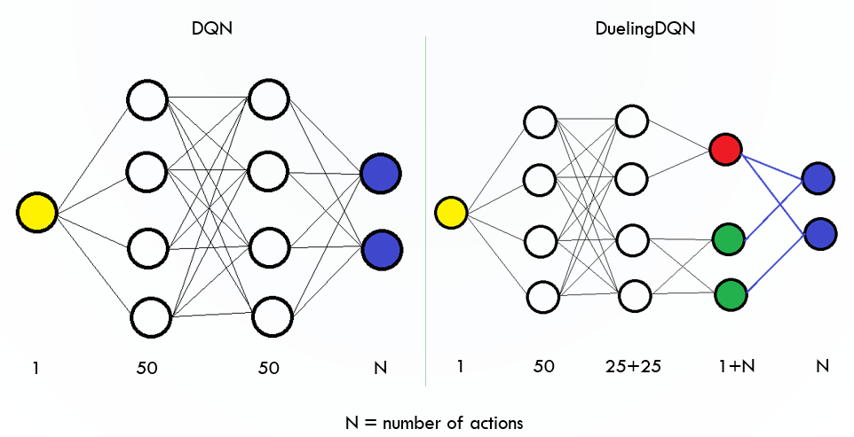

CORRIDOR EXAMPLE
$π≔ε$-greedy($π^{∗}$)
$$ε=0.001$$
$$γ=0.99$$
$$Q_{π}\left(s,a\right)= ?$$

Slide 16

ALGORITHM
Initialize a network of parameters $W$, $D$ replay buffer, $step=0$
fill $D$ with tuple of experience from policy $π$
for episode in 1:$M$:
random initialize $s$
while we do not end the game:
take action $a$ from $π(s,a)$
observe $r,s′$ from the environment, $step+=1$
fill D with $(s,a,r,s′)$
sample a mini batch from D: $\left\{\left(s_{1},a_{1},r_{1},s_{1}^{′},a_{1}^{′}\right), …, \left(s_{n},a_{n},r_{n},s_{n}^{′},a_{n}^{′}\right)\right\}$
use it to compute the targets: $u_{i}=r_{i}+γQ_{W}\left(s_{i}^{′},a_{i}^{′}\right)$
update the parameters with mini batch SGD: $W_{new}=W_{old}−\frac{η}{n}⋅∇_{W}\sum_{i=1…n}{{\left(u_{i}−Q_{W}\left(s_{i},a_{i}\right)\right)}^{2}}{\left.​\right|}_{W=W_{old}}$
update: $s=s′$
Replay Memory Buffer
SARSA target

Slide 17
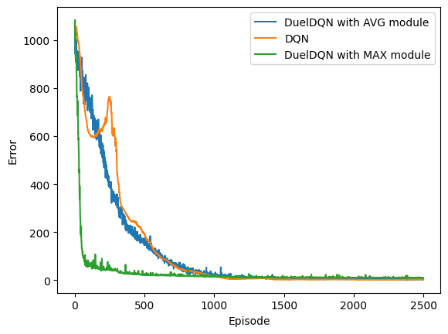
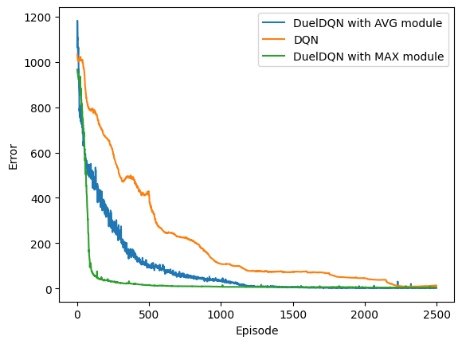
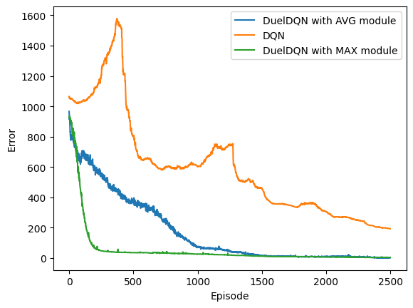

Error $=\frac{1}{N⋅70}\sum_{s,a}{{\left(Q_{W}\left(s,a\right)−Q_{π}\left(s,a\right)\right)}^{2}}$
N = 10
N = 20
N = 50

Slide 18

FUNCTION APPROXIMATION FOR POLICY LEARNING
$$π^{∗}= ?$$
We integrate policy evaluation steps
$$W_{k+1}=W_{k}−η⋅∇_{W}{\left(u_{k}−Q_{W}\left(s_{k},a_{k}\right)\right)}^{2}{\left.​\right|}_{W=W_{k}}$$
with policy improvement steps
$π_{k+1}≔ε$-greedy($π_{k}$)
In Q-learning we take
$$u_{k}=\max_{a′}{Q_{W_{k}}\left(s_{k+1},a′\right)}$$

Slide 19
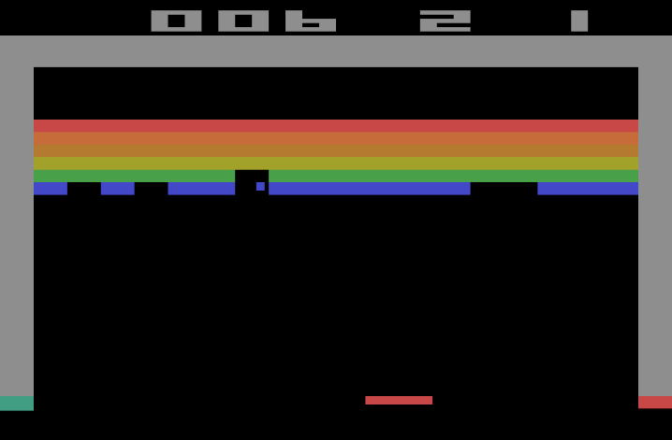

BREKOUT
$$γ=0.99$$
$$s∈R^{4×84×84}$$
$$Q^{∗}(s,a)= ?$$

Slide 20


ALGORITHM
Initialize a network of parameters $W$, the target network of parameters $W^{−}$, $D$ replay buffer, $ε=1$, $step=0$
fill $D$ with tuple of experience from a uniform policy
for episode in 1:$M$:
random initialize $s$
while we do not end the game:
take action $a$ from $U\left(A\right)$ with probability $ε$, from $a≔\underset{a}{argmax}{Q_{W}\left(s,a\right)}$with probability $1−ε$
observe $r,s′$ from the environment, $step+=1$
fill D with $(s,a,r,s′)$
sample a mini batch from D: $\left\{\left(s_{1},a_{1},r_{1},{s′}_{1}\right), …, \left(s_{n},a_{n},r_{n},{s′}_{n}\right)\right\}$
use it to compute the targets: $u_{i}=r_{i}+γ\max_{a′}{Q_{W^{−}}\left({s′}_{i},a′\right)}$
update the parameters with batch SGD: $W_{new}=W_{old}−\frac{η}{n}⋅∇_{W}\sum_{i=1…n}{{\left(u_{i}−Q_{W}\left(s_{i},a_{i}\right)\right)}^{2}}{\left.​\right|}_{W=W_{old}}$
update: $ε=ε_{end}−\left(ε_{start}−ε_{end}\right)⋅e^{−\frac{step}{d}}$, $s=s′$; if $step \% 1000=0$ then $W^{−}=W$
Replay Memory Buffer
Q-learning with target network
$ε$ decreasing exponentially

Slide 21
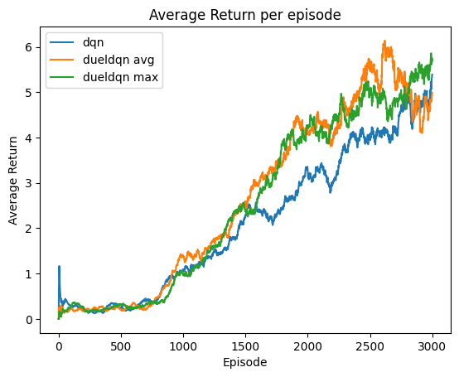
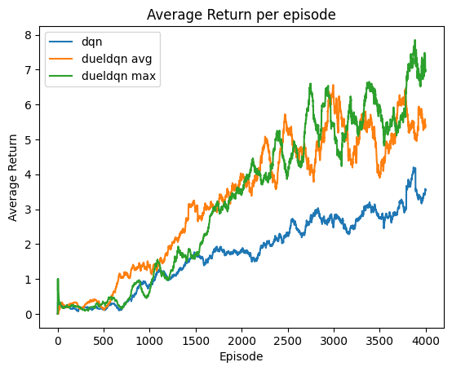
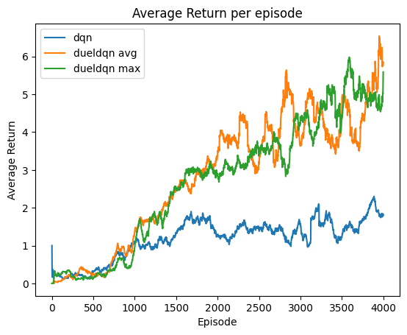


$$≔\frac{1}{100}\sum_{i=1…100}{g_{t+1−i}}$$
AVG return ($t$)
N = 10
N = 20
N = 35

Slide 22

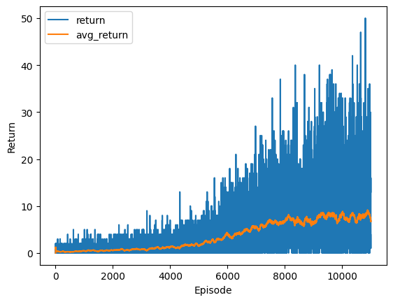
Results about Q-learning with dueling deep Q-network and AVG module, along 11000 episodes for 3 actions.
Then there are simulations using the learned policy at a certain step of the learning.

Slide 23




After 1000 episodes
After 3000 episodes
After 6000 episodes
After 10000 episodes

Slide 24
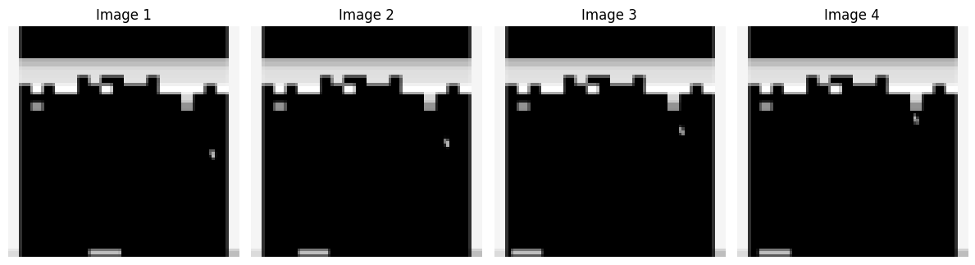

SALIENCY MAP
For a given state $\tilde{s}$ and action $\tilde{a}$, if $W$are the learned parameters,
$$∇_{s}V_{W}\left(s\right){\left.​\right|}_{s=\tilde{s}}= ?$$
$$∇_{s}{\hat{A}}_{W}\left(s,\tilde{a}\right){\left.​\right|}_{s=\tilde{s}}= ?$$
Let $\tilde{s}≔$

Slide 25
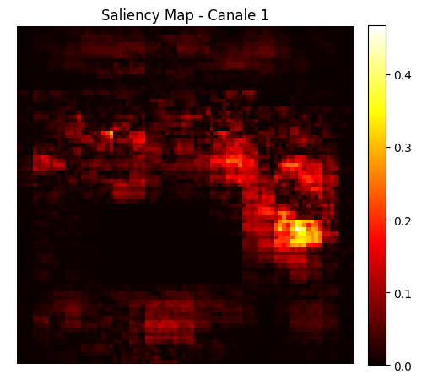
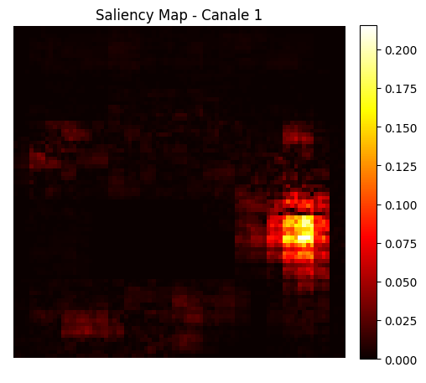
Value saliency map
Advantage saliency map

